Slide 1

FINAL PROJECT
Presented By : Abdelrahman Mohasseb
Depi | 2024

Slide 2
2
OVERVIEW
Abstract
Introduction
First Project
Key Deliverables and Milestones
second project
Key Deliverables and Milestones
Achivments
Any Questions
Thank You
Depi | 2024

Slide 3
2
ABSTRACT
We will talk about two projects today aimed at enhancing performance, scalability, and security for different organizations using AWS services. The first project focuses on transitioning a university’s student records system from an on-premises setup to a cloud-native solution, ensuring high availability, scalability, and improved performance during peak traffic periods. This will be achieved by implementing key AWS services such as EC2, RDS, VPC, and Application Load Balancer, alongside Auto Scaling, to handle dynamic traffic loads.
Depi | 2024

Slide 4
3
ABSTRACT
The second project emphasizes securing and monitoring cloud resources for AnyCompany Financial Bank. It involves implementing best practices for data protection, network security, and regulatory compliance using AWS tools like S3, KMS, VPC flow logs, and CloudWatch. Through these projects, we demonstrate how AWS can be leveraged to meet both performance and security requirements, while optimizing costs and ensuring resilience under high demand and security challenges.
Depi | 2024

Slide 5

4
INTRODUCTION
Both projects will follow a structured approach to ensure successful implementation, leveraging AWS services to address the unique challenges of performance, scalability, and security.
Depi | 2024

Slide 6
5
FIRST PROJECT
In this project, my objective is to build a cloud-native solution for hosting the university’s student records web application .
I’ll implement an architecture on AWS that supports thousands of concurrent users while maintaining high availability, scalability, and security. My approach will incorporate load balancing and auto-scaling to distribute traffic and handle demand spikes efficiently.
Depi | 2024

Slide 7
6
KEY DELIVERABLES AND MILESTONES
Architecture Design and Cost Estimation
Decoupling the Application Components
Depi | 2024
Deploying a Basic Web Application
Implementing High Availability and Scalability

Slide 8
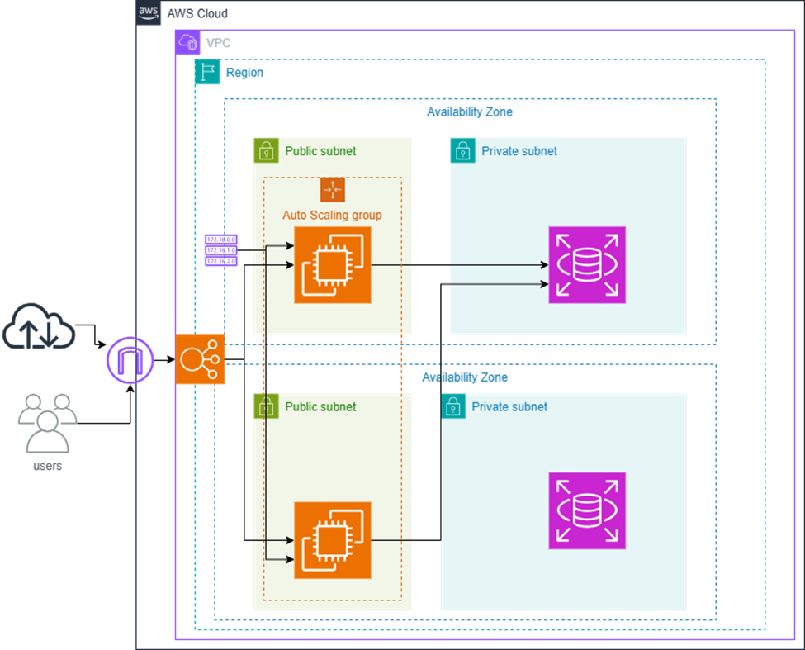
7
PHASE 1: PLANNING THE DESIGN AND ESTIMATING COST
Task 1: Creating an architectural diagram
Depi | 2024

Slide 9
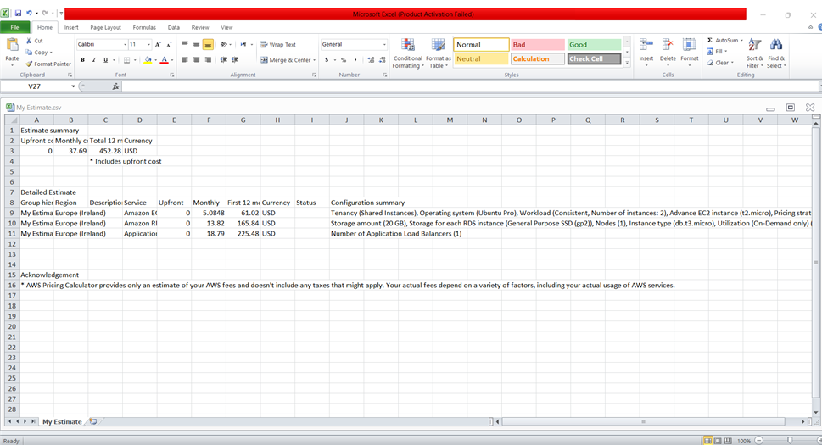
8
PHASE 1: PLANNING THE DESIGN AND ESTIMATING COST
Task 2: Developing a cost estimate
Depi | 2024

Slide 10
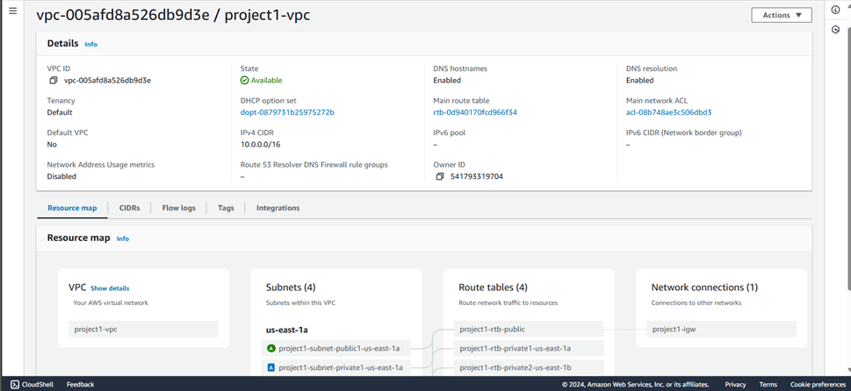
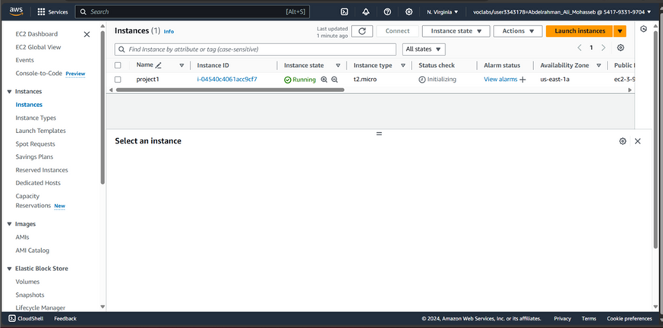
9
PHASE 2: CREATING A BASIC FUNCTIONAL WEB APPLICATION
Task 1: Creating a virtual network
Task 2: Creating a virtual machine
Depi | 2024

Slide 11
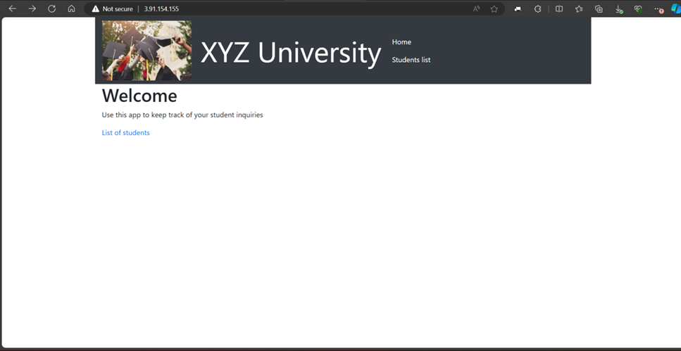
10
PHASE 2: CREATING A BASIC FUNCTIONAL WEB APPLICATION
Task 3: Testing the deployment
Depi | 2024

Slide 12
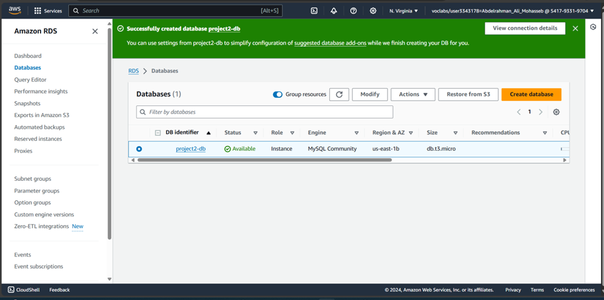
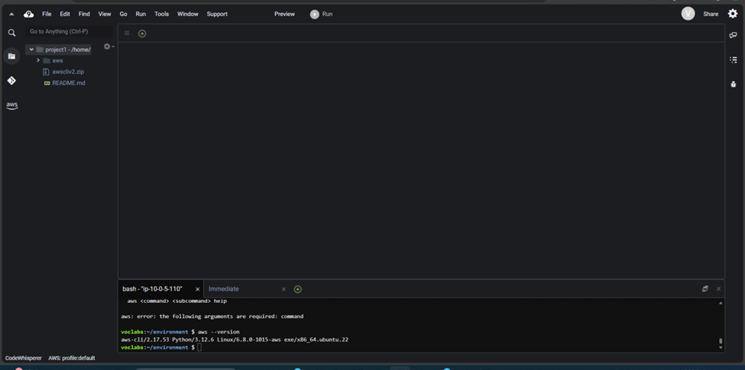
11
PHASE 3: DECOUPLING THE APPLICATION COMPONENTS
Task 2: Creating and configuring the Amazon RDS database
Task 3: Configuring the development environment
Depi | 2024

Slide 13
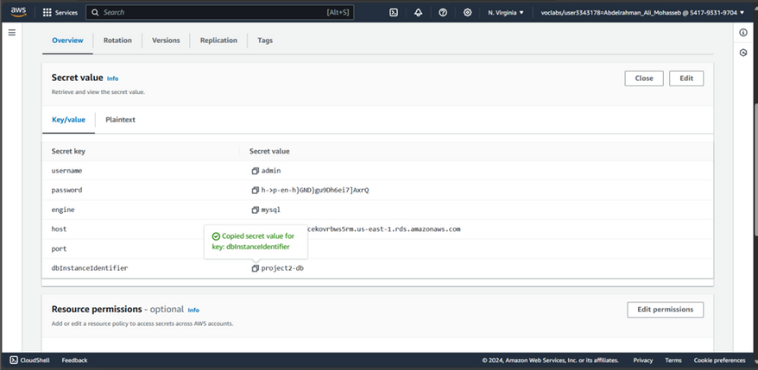
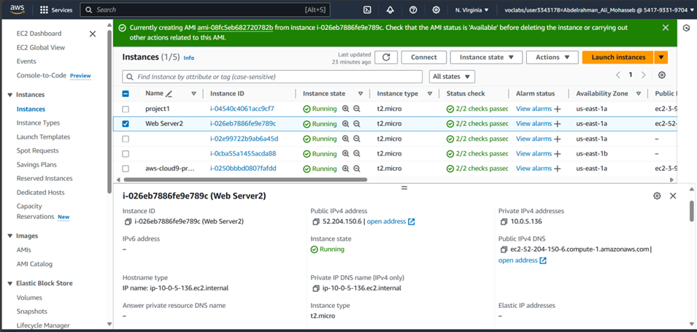
12
PHASE 3: DECOUPLING THE APPLICATION COMPONENTS
Task 4: Provisioning Secrets Manager
Task 5: Provisioning a new instance for the
web server
Depi | 2024

Slide 14
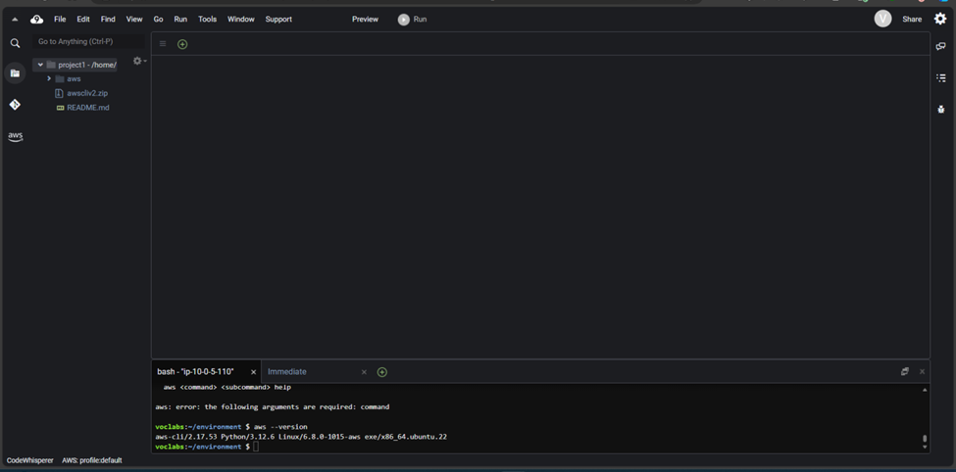
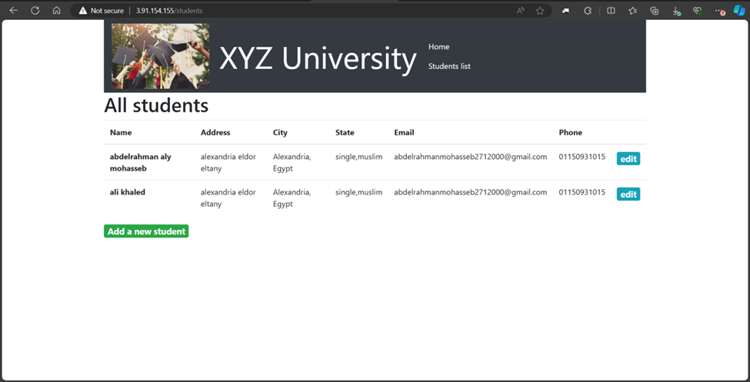
13
PHASE 3: DECOUPLING THE APPLICATION COMPONENTS
Task 6: Migrating the database
Task 7: Testing the application
Depi | 2024

Slide 15
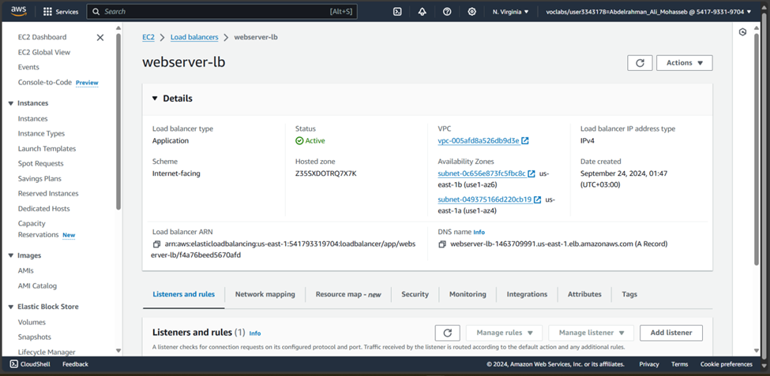
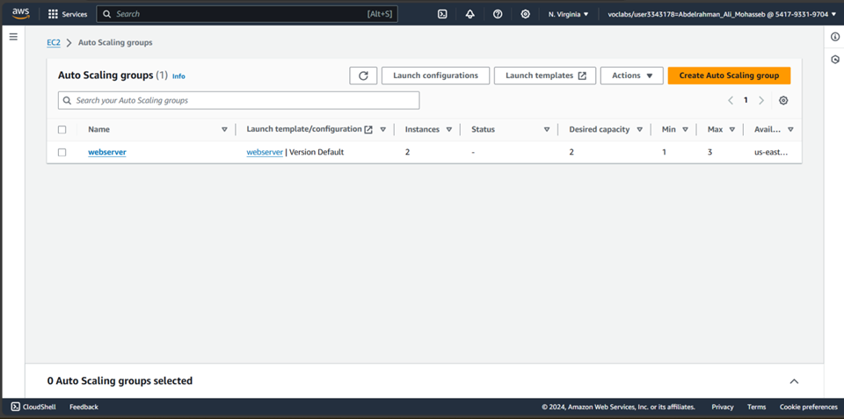
14
PHASE 4: IMPLEMENTING HIGH AVAILABILITY AND SCALABILITY
Task 1: Creating an Application Load Balancer
Task 2: Implementing Amazon EC2 Auto Scaling
Depi | 2024

Slide 16
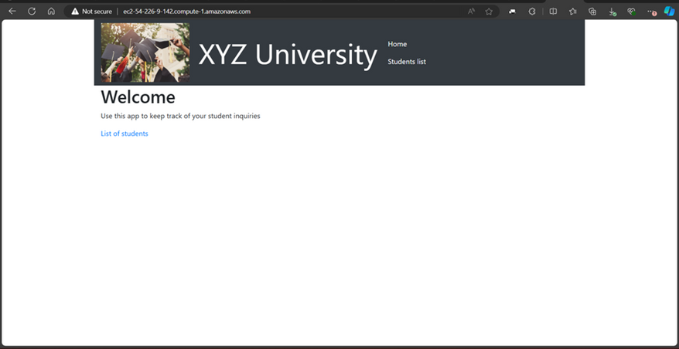
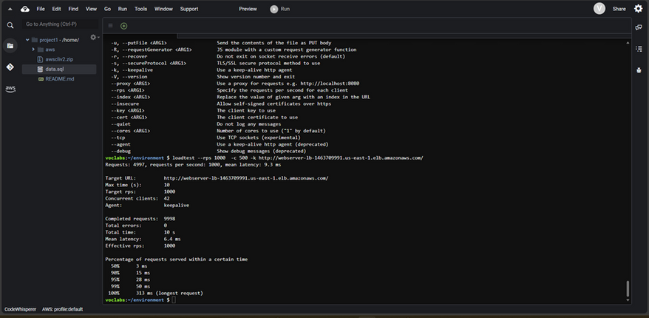
15
PHASE 4: IMPLEMENTING HIGH AVAILABILITY AND SCALABILITY
Task 3: Accessing the application
Task 4: Load testing the application
Depi | 2024

Slide 17
16
SECOND PROJECT
The objective of this project is to enhance the security and monitoring capabilities of AnyCompany Financial Bank's AWS cloud infrastructure. With the increasing importance of data protection, network security, and compliance with regulatory standards, this initiative focuses on implementing best practices that align with the AWS Well-Architected Framework. By the end of the project, the bank will have a robust security posture, ensuring the protection of sensitive information and resources.
Depi | 2024

Slide 18
17
KEY DELIVERABLES AND MILESTONES
Securing Data in Amazon S3
Securing VPCs
Depi | 2024
Securing AWS Resources with AWS KMS
Monitoring and Logging

Slide 19
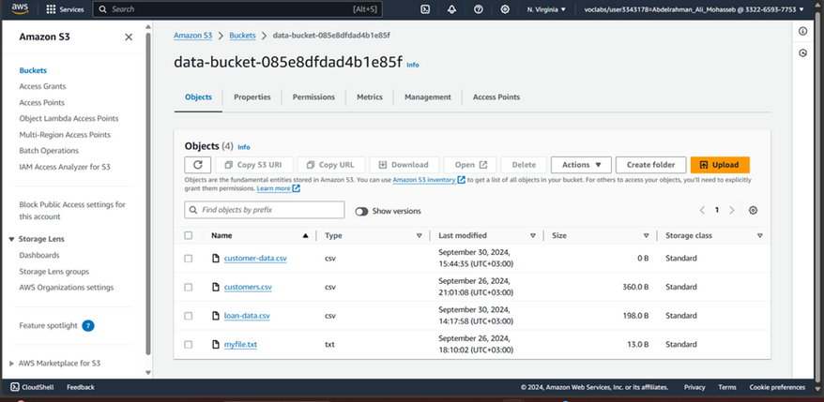
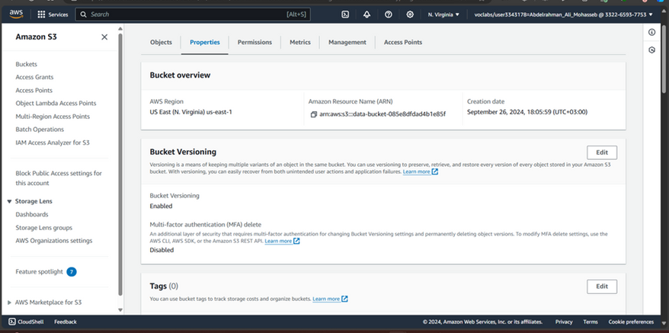
18
PHASE 1: SECURING DATA IN AMAZON S3
Task 1.1: Create a bucket, apply a bucket policy, and test access
Task 1.2: Enable versioning and object-level logging on a bucket
Depi | 2024

Slide 20
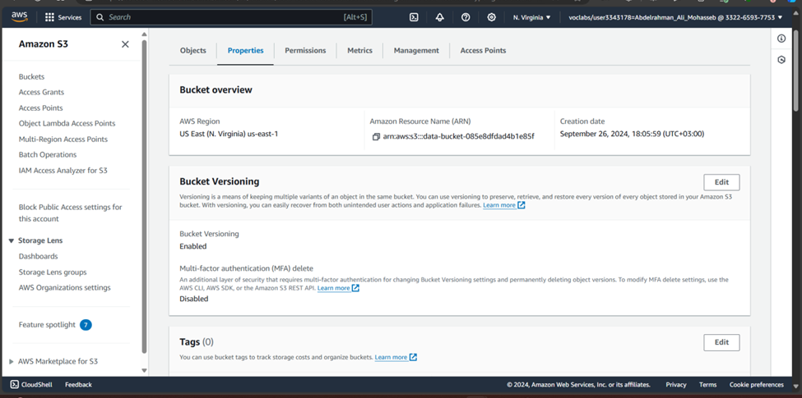
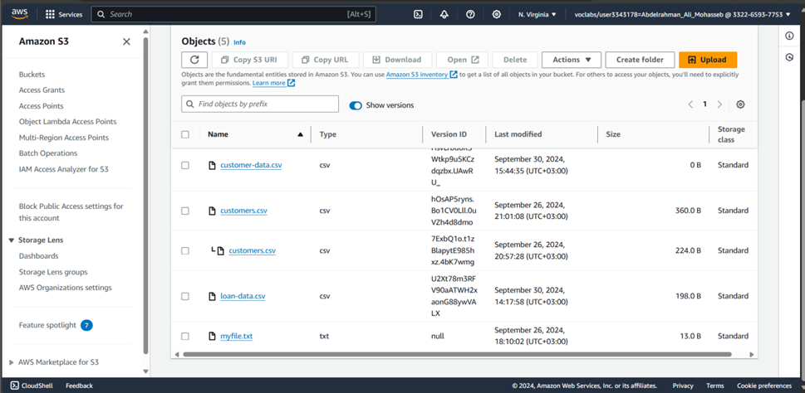
19
PHASE 1: SECURING DATA IN AMAZON S3
Task 1.3: Implement the S3 Inventory feature on a bucket
Task 1.4: Confirm that versioning works as intended
Depi | 2024

Slide 21
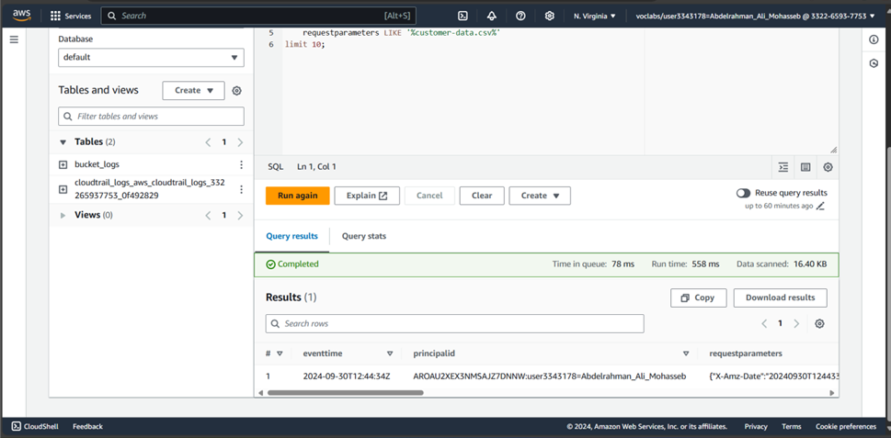
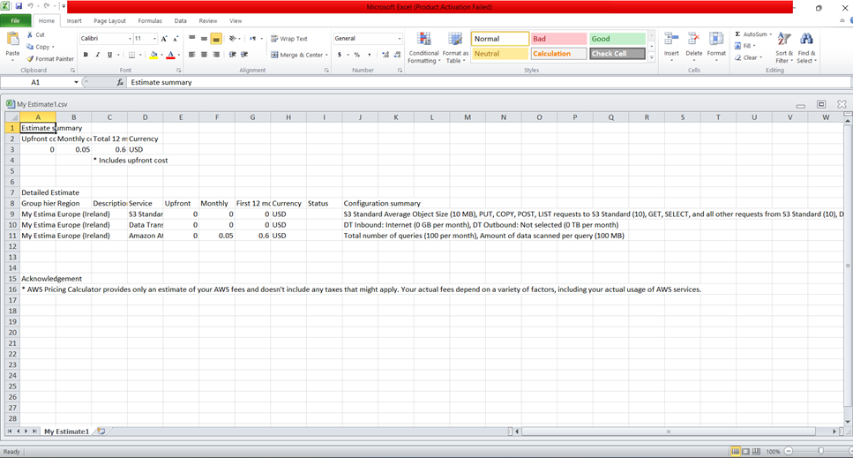
20
PHASE 1: SECURING DATA IN AMAZON S3
Task 1.5: Confirm object-level logging and query the access logs by using Athena
Cost assessment to secure Amazon S3
Depi | 2024

Slide 22
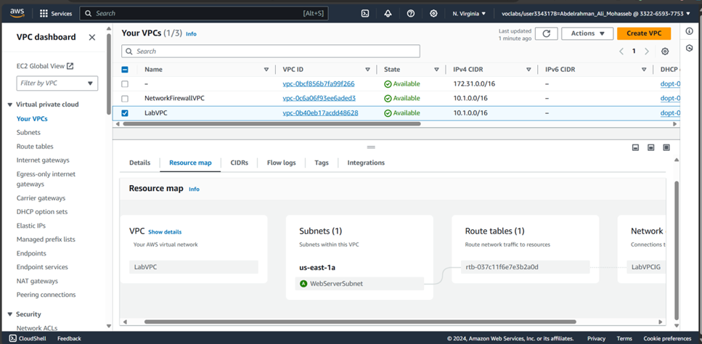
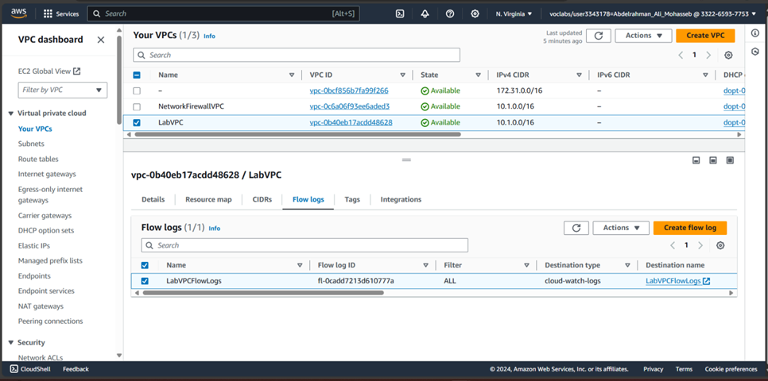
21
PHASE 2: SECURING VPCS
Task 2.1: Review LabVPC and its associated resources
Task 2.2: Create a VPC flow log
Depi | 2024

Slide 23
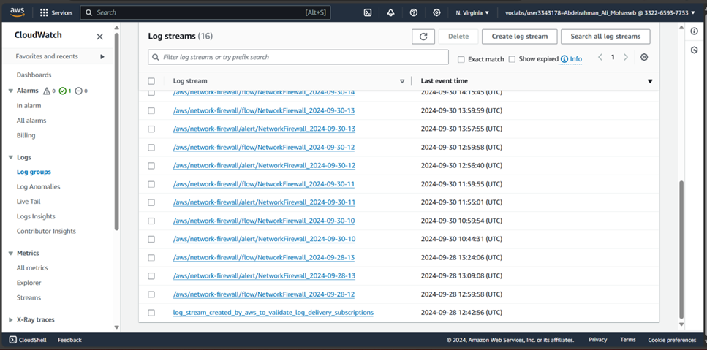
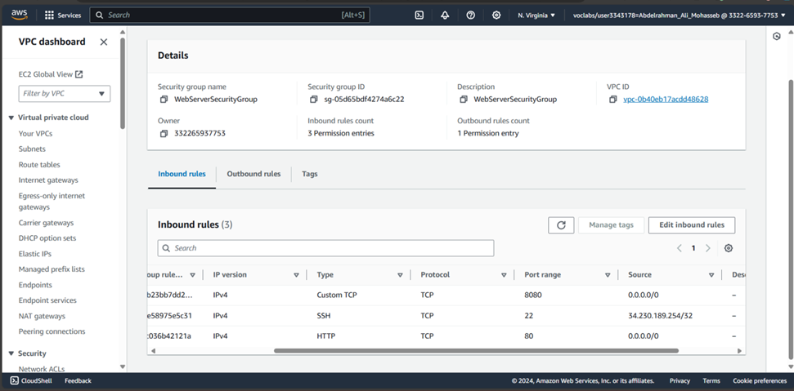
22
PHASE 2: SECURING VPCS
Task 2.3: Access the WebServer instance from the internet and review VPC flow logs in CloudWatch
Task 2.4: Configure route table and security group settings
Depi | 2024

Slide 24
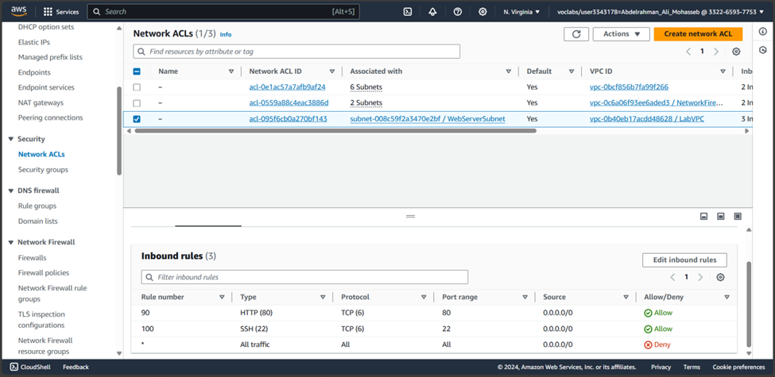
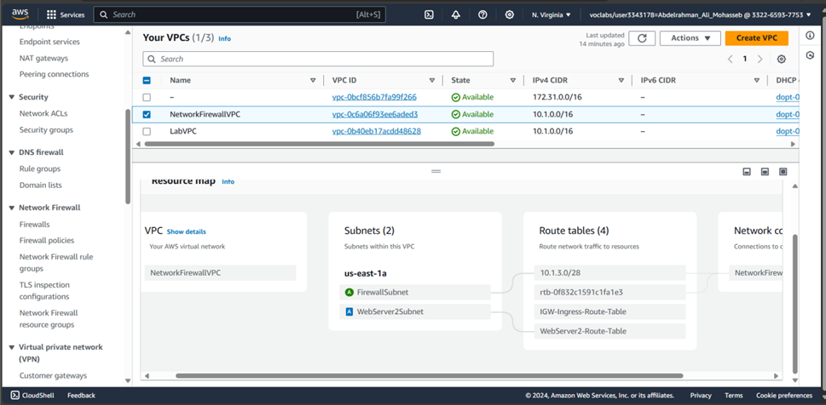
23
PHASE 2: SECURING VPCS
Task 2.5: Secure the WebServerSubnet with a network ACL
Task 2.6: Review NetworkFirewallVPC and its associated resources
Depi | 2024

Slide 25
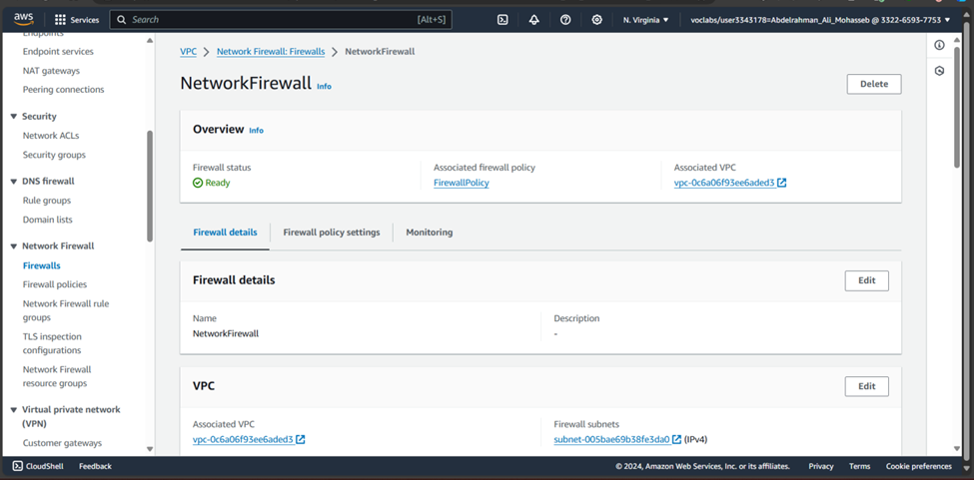
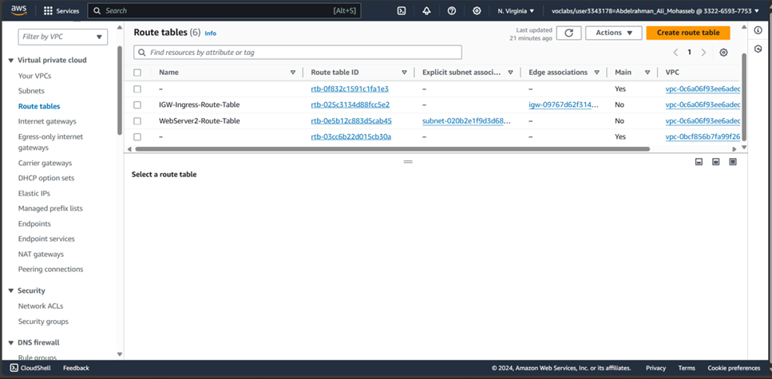
24
PHASE 2: SECURING VPCS
Task 2.7: Create a network firewall
Task 2.8: Create route tables
Depi | 2024

Slide 26
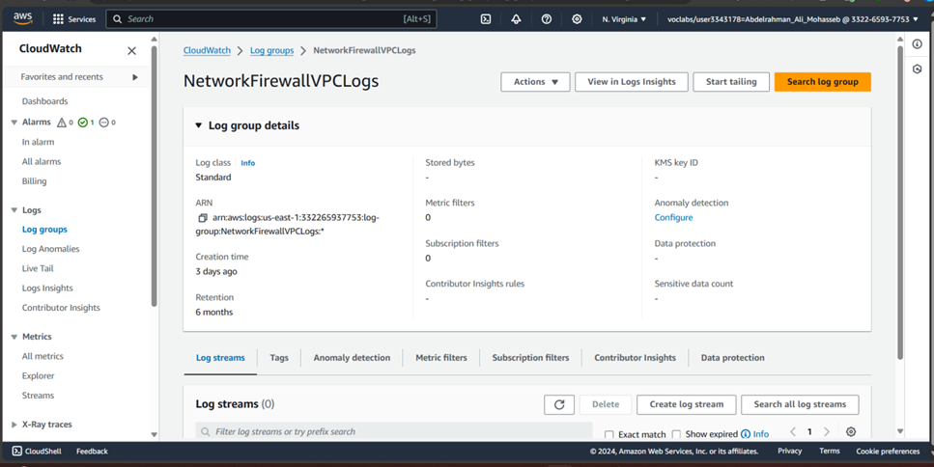
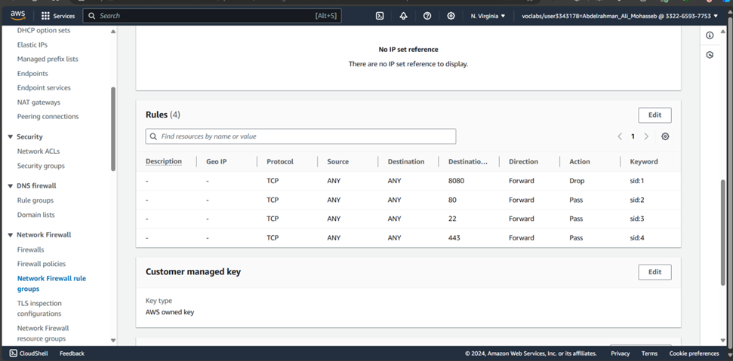
25
PHASE 2: SECURING VPCS
Task 2.9: Configure logging for the network firewall
Task 2.10: Configure the firewall policy and test access
Depi | 2024

Slide 27
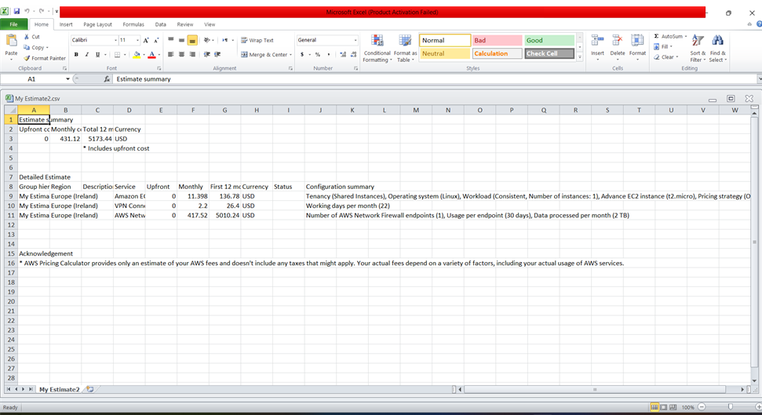
26
PHASE 2: SECURING VPCS
Cost estimate to secure a VPC with a network firewall
Depi | 2024

Slide 28
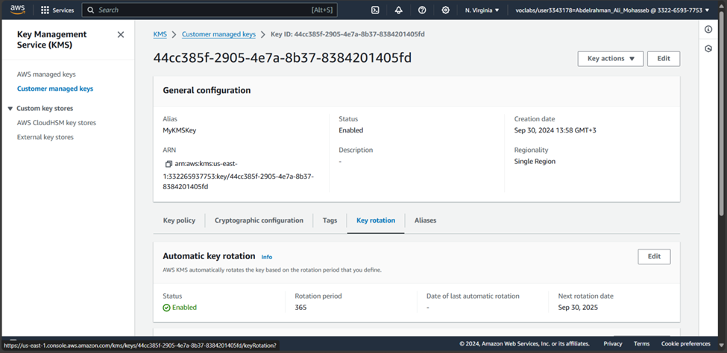
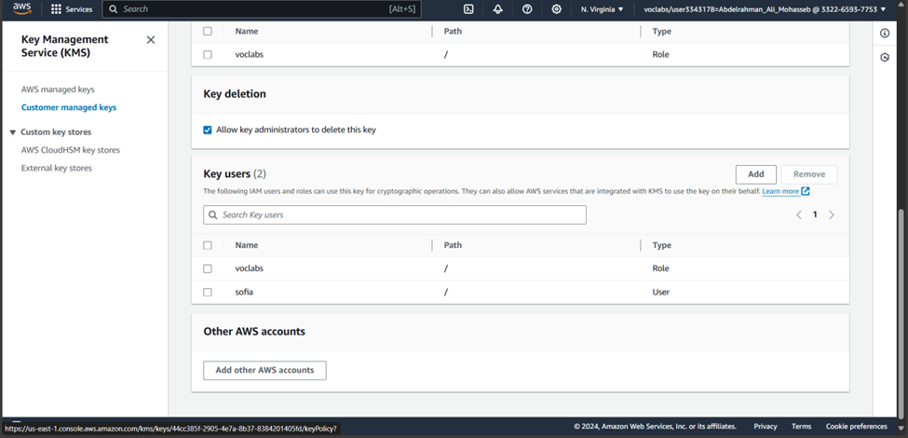
27
PHASE 3: SECURING AWS RESOURCES BY USING AWS KMS
Task 3.1: Create a customer managed key and configure key rotation
Task 3.2: Update the AWS KMS key policy and analyze an IAM policy
Depi | 2024

Slide 29
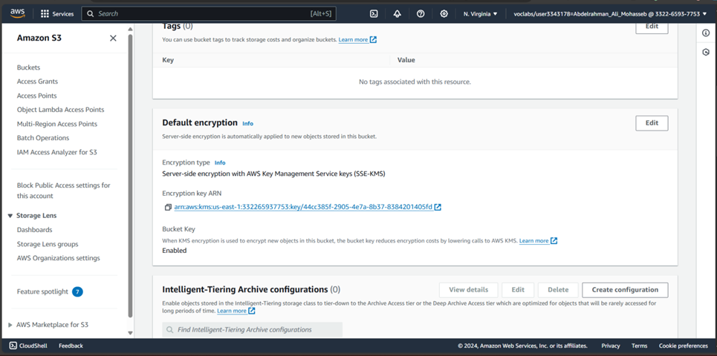
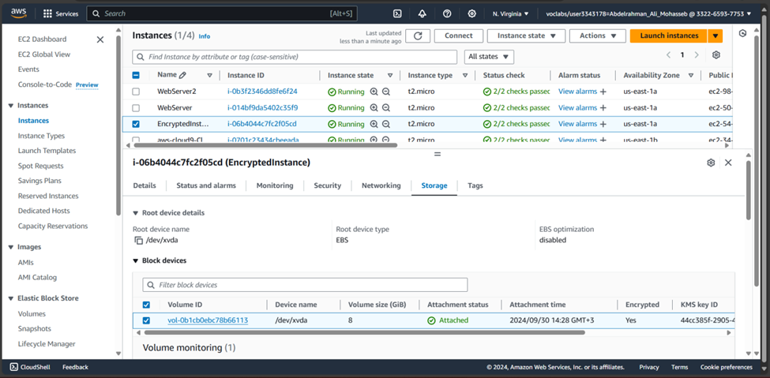
28
PHASE 3: SECURING AWS RESOURCES BY USING AWS KMS
Task 3.3: Use AWS KMS to encrypt data in Amazon S3
Task 3.4: Use AWS KMS to encrypt the root volume of an EC2 instance
Depi | 2024

Slide 30
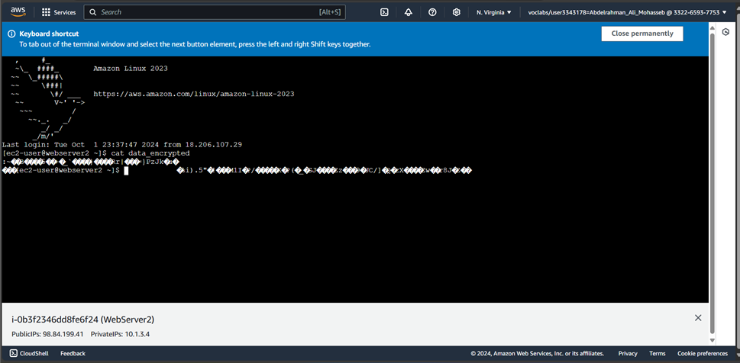
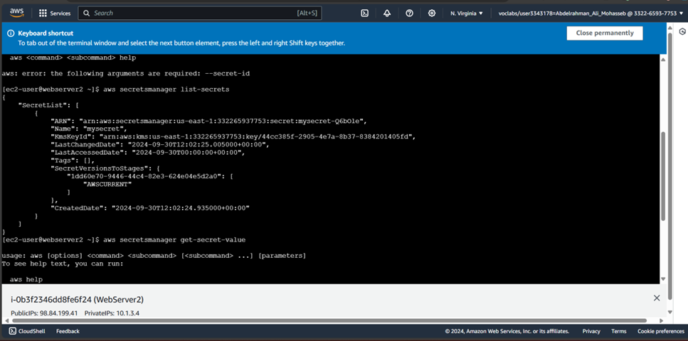
29
PHASE 3: SECURING AWS RESOURCES BY USING AWS KMS
Task 3.5: Use AWS KMS envelope encryption to encrypt data in place
Task 3.6: Use AWS KMS to encrypt a Secrets Manager secret
Depi | 2024

Slide 31
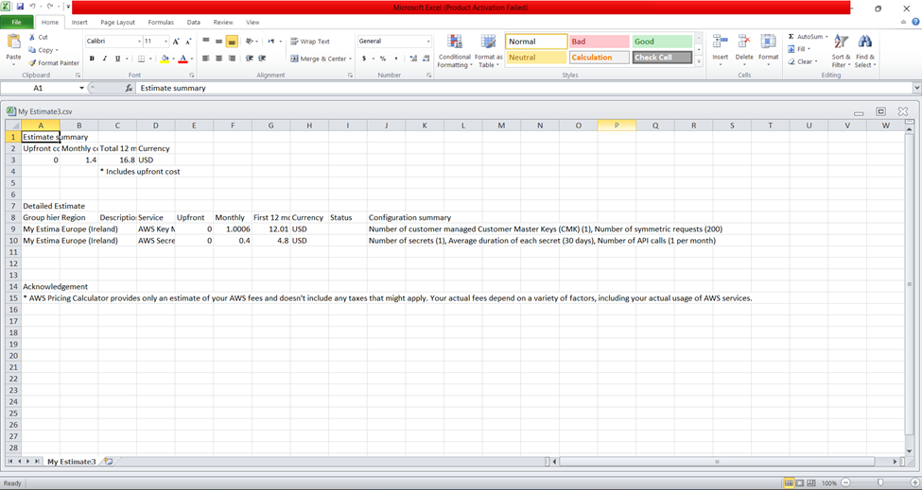
30
PHASE 3: SECURING AWS RESOURCES BY USING AWS KMS
Cost assessment for using AWS KMS
Depi | 2024

Slide 32
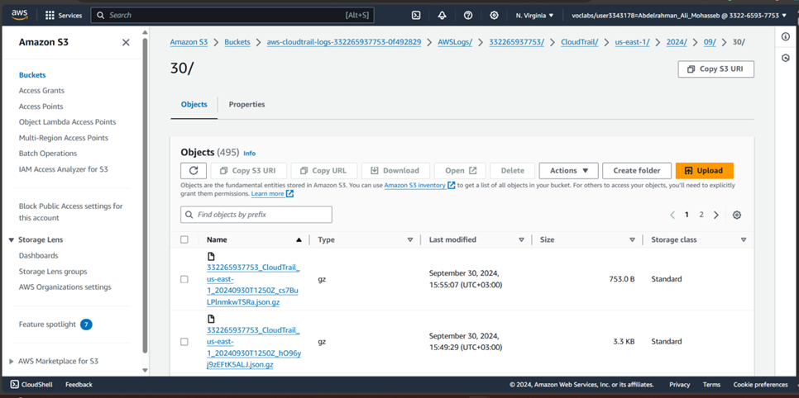
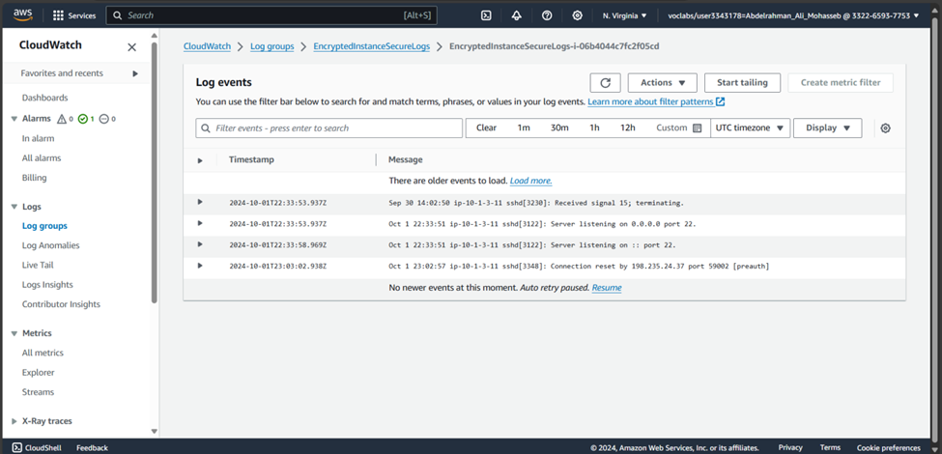
31
PHASE 4: MONITORING AND LOGGING
Task 4.1: Use CloudTrail to record Amazon S3 API callsTask
4.2: Use CloudWatch Logs to monitor secure logs
Depi | 2024

Slide 33
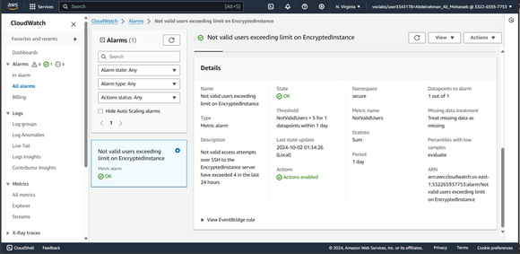
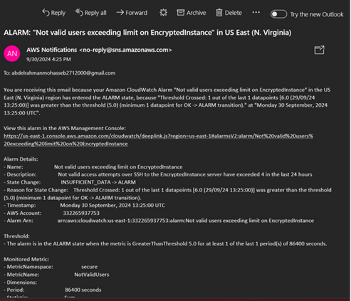
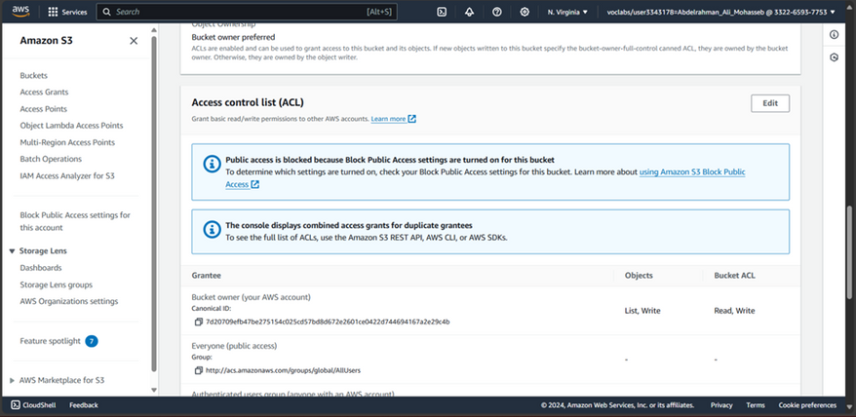
32
PHASE 4: MONITORING AND LOGGING
Task 4.3: Create a CloudWatch alarm to send notifications for security incidents
Task 4.4: Configure AWS Config to assess security settings and remediate the configuration of AWS resources
Depi | 2024

Slide 34
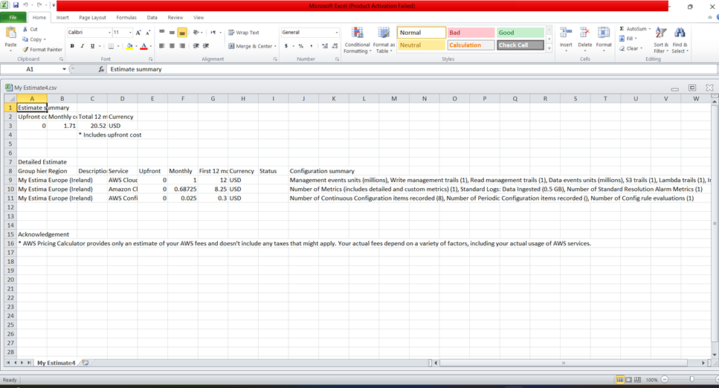
33
PHASE 4: MONITORING AND LOGGING
Cost assessment for monitoring and logging
Depi | 2024

Slide 35
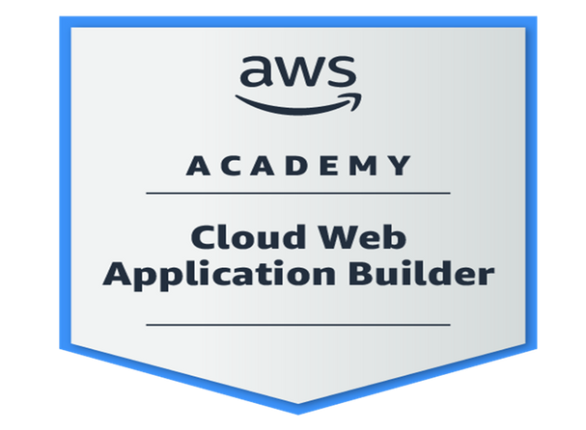
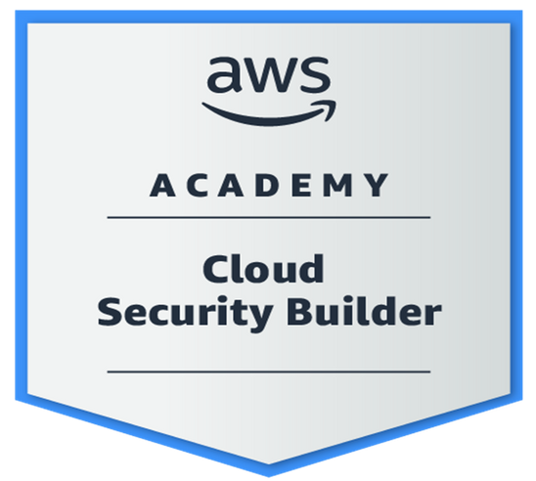
34
ACHIVMENTS
Depi | 2024

Slide 36
35
ANY QUESTIONS ?
Depi | 2024

Slide 37
Depi | 2024
THANK YOU
Presented By : Abdelrahman Mohasseb

